Slide 1
ML and AI on AWS
AWS Machine Learning and Artificial Intelligence Primer
Delivered by: Noureddin Sadawi, PhD

Slide 2
About the Speaker
Name: Dr Noureddin Sadawi
Qualification: PhD Computer Science
Experience: Several areas including but not limited to Docker, Machine Learning and Data Science, Python and much more

Slide 3
The Environment
Install AWS CLI on your machine https://aws.amazon.com/cli/
We will use it later for demonstrating invocation of services from outside of AWS (REGION is important)
Create a user on IAM and assign permissions
Configure CLI:
aws configure
Provide required access and secret keys
Verify Access - List S3 Buckets in the account
aws s3 ls

Slide 4
Github Repo
All code is available here:
https://github.com/nsadawi/AWS-ML-Primer

Slide 5
About the Services
Some of the services we are going to learn in this course are new
Services are constantly updated, improved and extended
You are learning them at the right time
Analyze Voice, Text, Video, Image
Natural Language, Image, Video Analysis

Slide 6
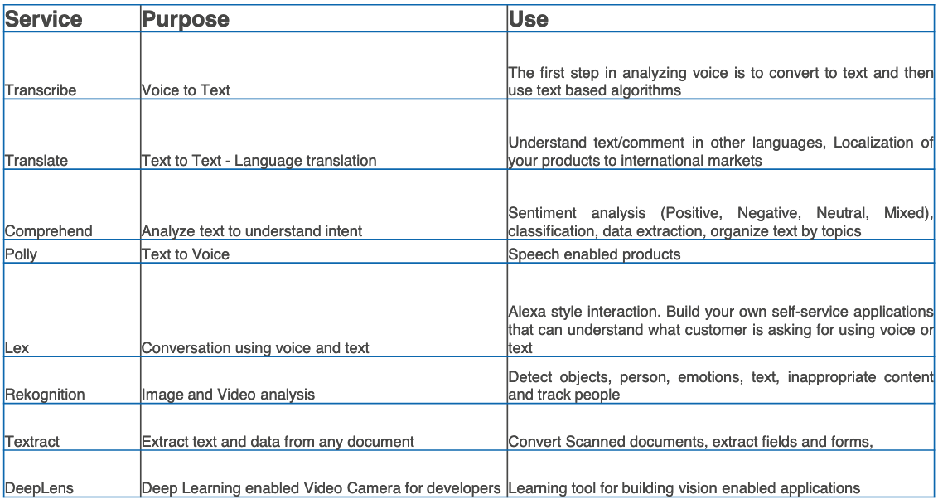
Summary

Slide 7
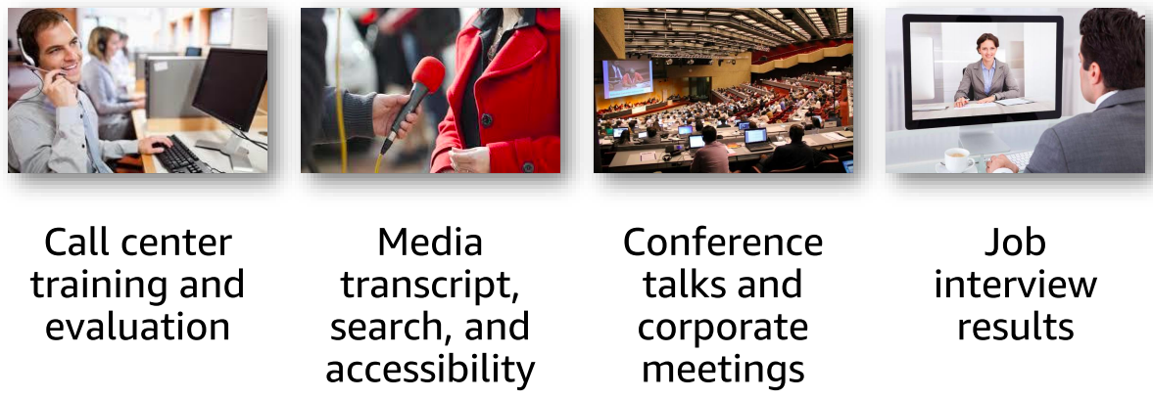
Transcription, Translation, and subtitles
Need: fast, accurate and affordable transcription and translation

Slide 8
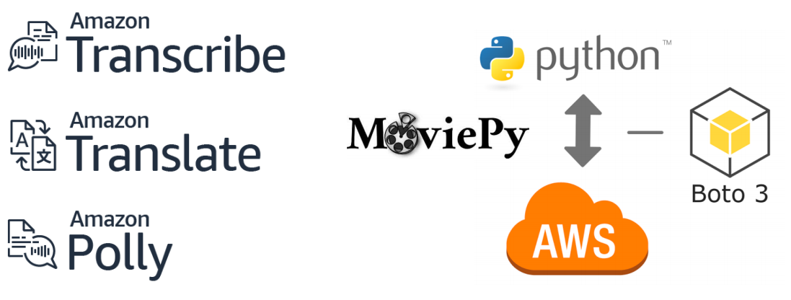
Example Use Case: Movie Subtitles
These tools can help you achieve a lot .. programmatically!

Slide 9
Amazon Transcribe
“Audio data is virtually impossible for computers to search and analyze. Therefore, recorded speech needs to be converted to text before it can be used in applications”
https://aws.amazon.com/transcribe/

Slide 10
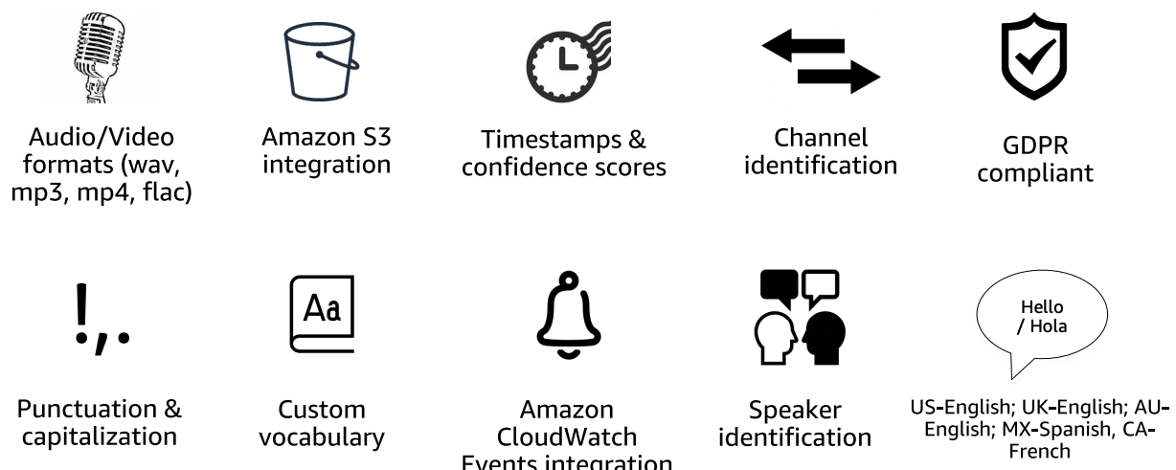
Amazon Transcribe
Amazon Transcribe is an automatic speech recognition (ASR) service that makes it easy for developers to add speech-to-text capability to applications
Works well in batch mode
Available at: https://aws.amazon.com/transcribe/

Slide 11
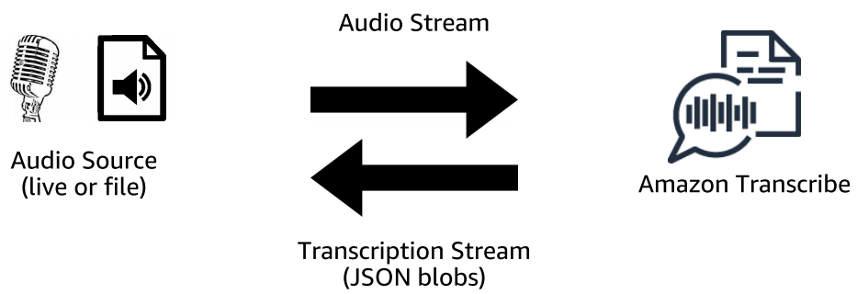
Amazon Transcribe
Amazon Transcribe: Automatic speech recognition (streaming mode)
https://docs.aws.amazon.com/code-samples/latest/catalog/code-catalog-python-example_code-transcribe.html

Slide 12

Amazon Transcribe
Caption
Text Search
Transcribe
Comprehend
Translate

Slide 13
Amazon Transcribe Features
Automatically adds punctuation and formatting
Batch and Real-time transcription
Timestamp for each word – easily locate in original media
Custom Vocabulary Support
Detect and Tag multiple Speakers

Slide 14
Amazon Transcribe Vocabulary
What if the transcription contains mistakes?
It is possible to provide Custom Vocabulary
Two ways:
Vocabulary List
Or Vocabulary Table
More details here: https://docs.aws.amazon.com/transcribe/latest/dg/how-vocabulary.html

Slide 15
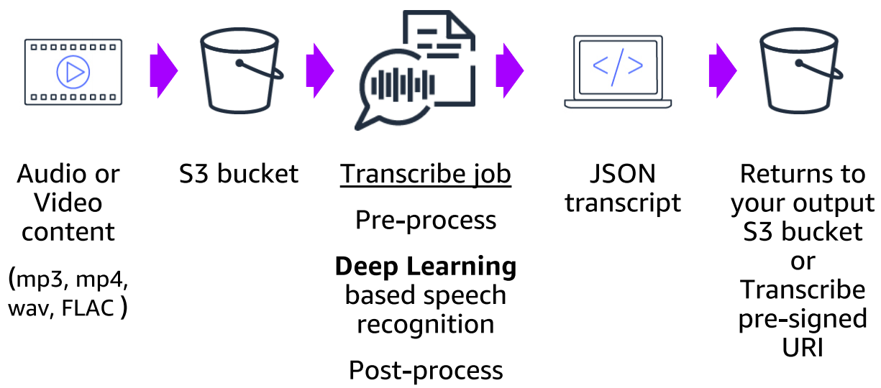
Amazon Transcribe
How Amazon Transcribe works (batch mode)

Slide 16
Amazon Translate
سلام
paz
Peace
Translate
pace
maluhia

Slide 17
Amazon Translate
Understand reviews, text, comment in other languages
Localization of your products and services
Custom Terminology Support
Real-time and Batch translation

Slide 18
Amazon Translate
“This is a neural machine translation service, which is a form of language translation automation that uses deep learning models to deliver more accurate and more natural sounding translation than traditional statistical and rule-based translation algorithms. The engines are trained on a wide variety of content across different use cases and domains to perform well on many kinds of content.”
https://aws.amazon.com/translate/details/

Slide 19
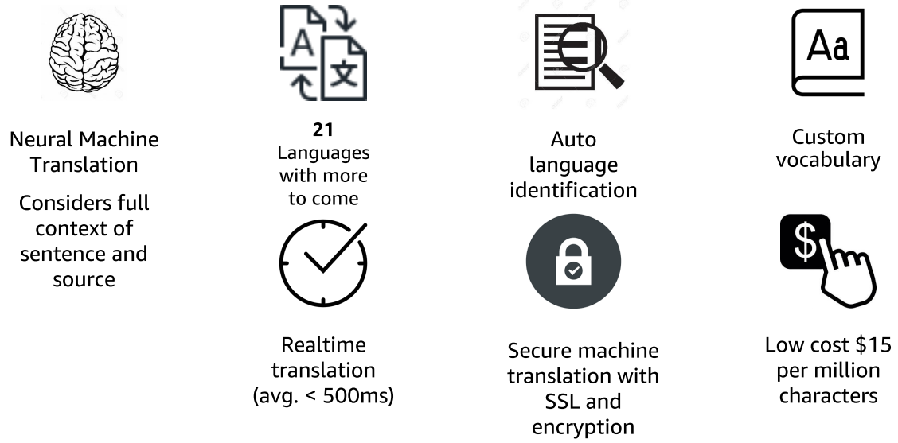
Amazon Translate
Amazon Translate: Neural network-based translation

Slide 20
Translate (Python)
These tools can help you achieve a lot .. programmatically!
https://docs.aws.amazon.com/translate/latest/dg/examples-python.html

Slide 21
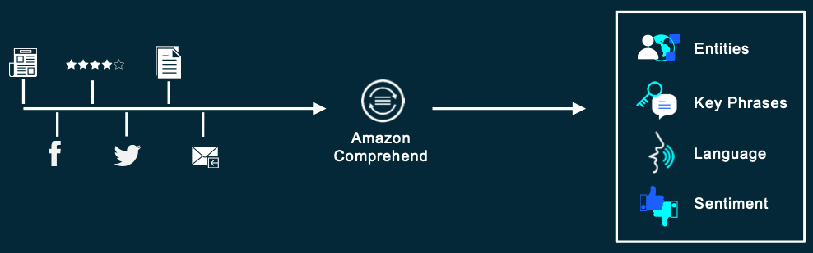
Amazon Comprehend
This service helps you Discover insights and relationships in text
The underlying technology is based on Deep Learning

Slide 22
Amazon Comprehend
Sentiment
Some Text
Classify
Comprehend
Medical
Syntax

Slide 23
Comprehend Medical
“Amazon Comprehend Medical detects and returns useful information in unstructured clinical text such as physician's notes, discharge summaries, test results, and case notes. Amazon Comprehend Medical uses natural language processing (NLP) models to detect entities, which are textual references to medical information such as medical conditions, medications, or Protected Health Information(PHI)”
https://docs.aws.amazon.com/comprehend/latest/dg/comprehend-med.html

Slide 24
Text Analysis
Amazon.com, Inc. is located in Seattle, WA and was founded July 5th, 1994 by Jeff Bezos. Our customers love buying everything from books to blenders at great prices
Named Entities
Amazon.com: Organization
Seattle, WA : Location
July 5th,1994: Date
Jeff Bezos : Person
Keyphrases
Our customers
books
blenders
great prices
Sentiment: Positive
Language: English

Slide 25
Why Text Analysis?
Enabling The Possibility for These Use Cases
News Media
Brand trends, correlating events
Customer engagement
Call center, issue triage, social media analytics
Records and research
Actionable document-centric processes, understand patterns

Slide 26
Amazon Comprehend
Keyphrase Extraction
Sentiment Analysis
Syntax Analysis
Entity Recognition
Medical Information Extraction
Custom Entities
Classification
Topic Modeling

Slide 27
Amazon Comprehend
DetectDominantLanguage and BatchDetectDominantLanguage – to detect the dominant language in a document (currently up to ~100 languages)
DetectEntities and Batch DetectEntities – to detect the entities, such as persons or places, in the document(s)
DetectKeyPhrases and Batch DetectKeyPhrases – to detect key noun phrases that are most indicative of the content
DetectSentiment and Batch DetectSentiment – to detect the emotional sentiment, positive, negative, mixed, or neutral, of a document

Slide 28
Classification with Comprehend
It is possible to train Comprehend using your own data (Text based custom classification)
Moderating Comments and Reviews
Organizing Documents by Category
Example:
Objective: Identify tweets that require follow-up

Slide 29
Amazon Comprehend
Available at: https://aws.amazon.com/comprehend/
Getting started: https://aws.amazon.com/getting-started/hands-on/analyze-sentiment-comprehend/
Comprehend API (Python): https://docs.aws.amazon.com/code-samples/latest/catalog/code-catalog-python-example_code-comprehend.html

Slide 30

Amazon Polly
Some Text
Polly

Slide 31
Amazon Polly
Text To Speech Service (TTS)
Speech Enabled Products
Real-time or batch mode
Wide selection of voices, languages
Customize with SSML (Speech Synthesis Markup Language)

Slide 32
Polly SSML
Control how Polly generates speech from text
Adjust pause, speech rate, pitch
Emphasis of sounds, Phonetic pronunciation
Newscaster

Slide 33

Polly Use-case
Transcribe
Comprehend
Polly
https://docs.aws.amazon.com/polly/latest/dg/python-samples-overall.html

Slide 34
Amazon Lex
Amazon Lex is a service for building conversational interfaces into any application using voice and text
Amazon Lex provides the advanced deep learning functionalities of automatic speech recognition (ASR) for converting speech to text, and natural language understanding (NLU) to recognize the intent of the text, to enable you to build applications with highly engaging user experiences and lifelike conversational interactions
With Amazon Lex, the same deep learning technologies that power Amazon Alexa are now available to any developer, enabling you to quickly and easily build sophisticated, natural language, conversational bots (“chatbots”)

Slide 35

Amazon Lex
Lex
Lambda

Slide 36
Amazon Lex - Terminology 1/2
Bot: A bot performs automated tasks such as ordering a pizza, booking a hotel, ordering flowers, and so on
Amazon Lex bots can understand user input provided with text or speech and converse in natural language
You can create Lambda functions and add them as code hooks in your intent configuration to perform user data validation and fulfillment tasks
Intent: An intent represents an action that the user wants to perform
You create a bot to support one or more related intents. For example, you might create a bot that orders pizza and drinks

Slide 37
Amazon Lex - Terminology 2/2
For each Intent, you provide the following required information:
Intent name: A descriptive name for the intent. For example, OrderPizza
Sample utterances: How a user might convey the intent. For example, a user might say “Can I order a pizza please” or “I want to order a pizza”
How to fulfill the intent: How you want to fulfill the intent after the user provides the necessary information (for example, place order with a local pizza shop)
Slot — An intent can require zero or more slots or parameters. You add slots as part of the intent configuration. At runtime, Amazon Lex prompts the user for specific slot values. The user must provide values for all required slots before Amazon Lex can fulfill the intent

Slide 38
Create a Custom Bot
It is easy to create a custom bot using Lex
you use the Amazon Lex console to create a custom bot
You configure the bot by adding a custom intent
You can define custom slot types, and define the slots required for fulfillment
More here: https://docs.aws.amazon.com/lex/latest/dg/getting-started-ex2.html

Slide 39
End of
Session 1

Slide 40
Amazon Rekognition
It is Deep Learning-Based Image Recognition Service
Analyze Video and Extract Rich Metadata
Detect, Analyze, and Compare Faces
Deep Dive on Amazon Rekognition
https://eu-west-2.console.aws.amazon.com/rekognition/home?region=eu-west-2#/
https://docs.aws.amazon.com/rekognition/latest/dg/what-is.html
Notes:
https://docs.aws.amazon.com/rekognition/latest/dg/rekognition-dg.pdf

Slide 41

Amazon Rekognition
Recognition
Facial Analysis
Rekognition
Content Labeling
and more
https://docs.aws.amazon.com/code-samples/latest/catalog/code-catalog-python-example_code-rekognition.html

Slide 42
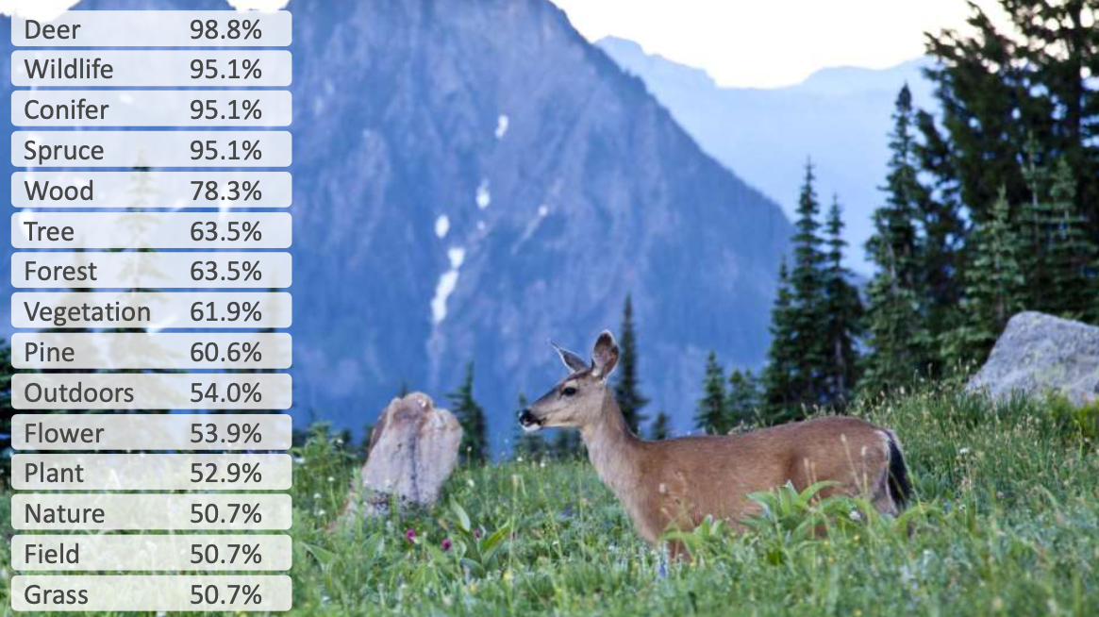
Usage Example

Slide 43
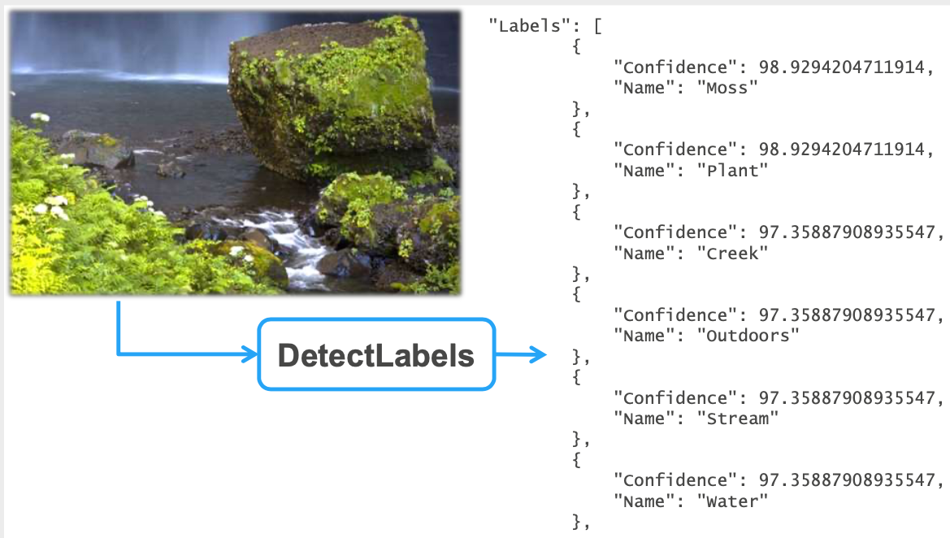
Usage Example

Slide 44
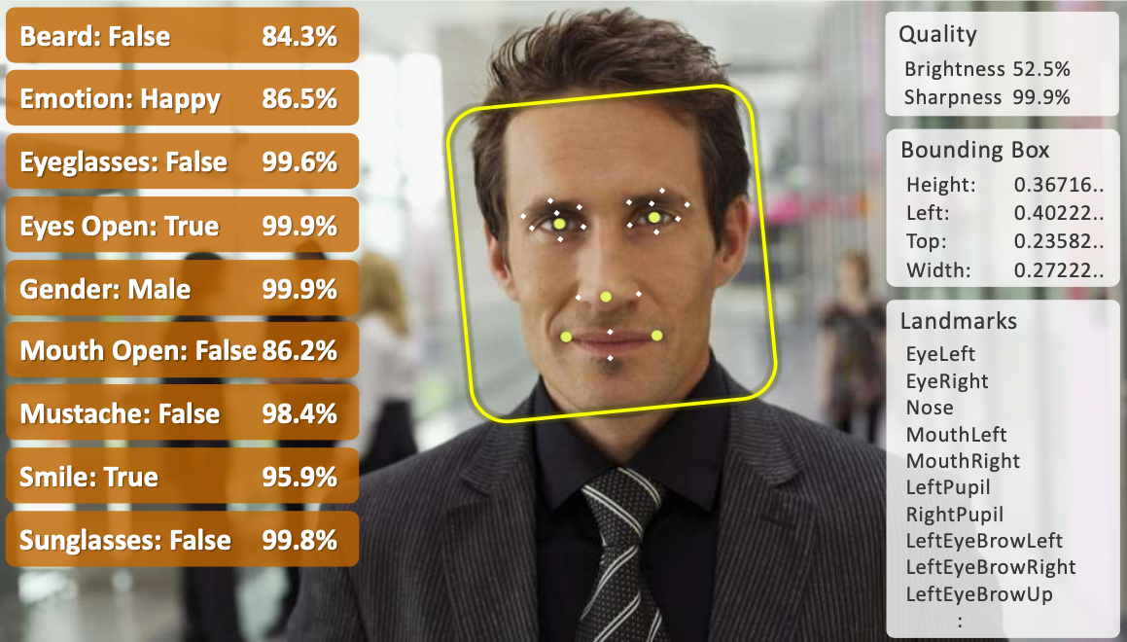
Usage Example

Slide 45
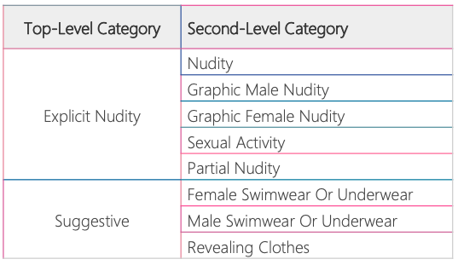
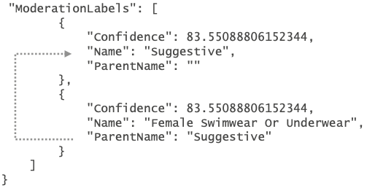
Image Moderation
Detect images with explicit or suggestive adult content
Automate and optimize manual review processes
Hierarchical taxonomy provides greater control for geo-sensitive content

Slide 46
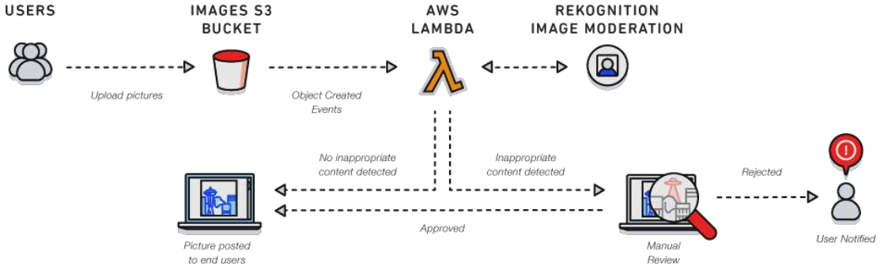
Optimize Manual Review Process
Automating the detection of inappropriate content with Rekognition
Reducing volume of images for human curation increases review quality

Slide 47
Real-world Examples
Law Enforcement and Public Safety
Travel and Hospitality
Digital Marketing and Advertising
Media and Entertainment
Internet of Things (IoT)

Slide 48
Real-world Example
Washington County Sheriff (OR)
To follow leads from citizens & security cameras, a person spends days manually searching thousands of images
A mobile and web app powered by Amazon Rekognition compares new images with photos of previous offenders:
Helps identify unknown theft suspects from security footage
Provides leads by identifying possible witnesses & accomplices
Identifies persons of interest who do not have identification

Slide 49
End of
Session 1

Slide 50
SageMaker
Amazon SageMaker is a fully managed service that provides every developer and data scientist with the ability to build, train, and deploy machine learning (ML) models quickly
SageMaker removes the heavy lifting from each step of the machine learning process to make it easier to develop high quality models
https://aws.amazon.com/sagemaker/

Slide 51
SageMaker
Fully managed Cloud based machine learning service
Build – Jupyter Notebook development environment
Train – Managed Training infrastructure
Deploy – Scalable Hosting infrastructure

Slide 52
SageMaker - Build
Managed Jupyter Notebook Environment
Extensive collection of popular Machine Learning Algorithms
Pre-configured to run TensorFlow and Apache MxNet
Bring-Your-Own Algorithm

Slide 53
SageMaker - Train
Distribute training across one or many instances
Managed model training infrastructure
Scales to Petabyte datasets
Compute instances for training are automatically launched and released – Stores artifacts in S3

Slide 54
Deploy for Real-time Prediction
Real-time Endpoint for interactive and low-latency use-cases
AutoScaling:
Maintain adequate capacity
Replace unhealthy instances
Dynamically scale-out and scale-in based on workload
https://docs.aws.amazon.com/sagemaker/

Slide 55
Deploy for Batch Transformation
Suitable for these scenarios:
Inference for your entire dataset
Don’t need a persistent real-time endpoint
Don’t need sub-second latency performance
https://docs.aws.amazon.com/sagemaker/latest/dg/how-it-works-batch.html

Slide 56
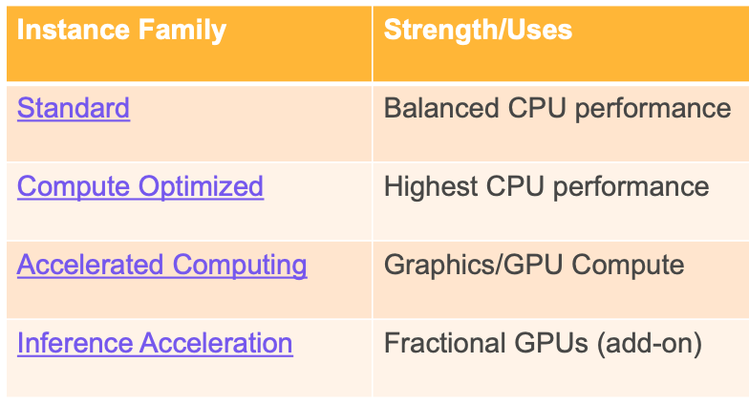
Instance Family
https://aws.amazon.com/sagemaker/pricing/

Slide 57
Useful Resources
There are plenty of resources out there
Some nice presentations are here: http://aws-reinvent-audio.s3-website.us-east-2.amazonaws.com/2019/2019_presentations.html
Let’s check this one out:
https://d1.awsstatic.com/events/reinvent/2019/Amazon_SageMaker_deep_dive_A_modular_solution_for_machine_learning_AIM307.pdf

Slide 58
Amazon Personalize
Personalize allows you to get your first recommendation engine running quickly, to deliver immediate value to your end user or business
As your understanding increases (or if you are already familiar with data science), you can take advantage of the deep capabilities of Amazon Personalize to improve your recommendations
https://aws.amazon.com/blogs/machine-learning/creating-a-recommendation-engine-using-amazon-personalize/
https://d1.awsstatic.com/events/reinvent/2019/REPEAT_1_Build_a_content-recommendation_engine_with_Amazon_Personalize_AIM304-R1.pdf

Slide 59
Amazon CodeGuru
Helps you find Find your most expensive lines of code
A developer tool powered by machine learning that provides intelligent recommendations for improving code quality and identifying an application’s most expensive lines of code.
Integrate Amazon CodeGuru into your existing software development workflow where you will experience built-in code reviews to detect and optimize the expensive lines of code to reduce costs

Slide 60
Amazon CodeGuru
Amazon CodeGuru Profiler helps developers find an application’s most expensive lines of code along with specific visualizations and recommendations on how to improve code to save money. Learn more »
Amazon CodeGuru Reviewer uses machine learning to identify critical issues and hard-to-find bugs during application development to improve code quality. Learn more »
https://aws.amazon.com/codeguru/

Slide 61

Amazon Fraud Detector
A fraud detection service that makes it easy for businesses to use machine learning to detect online fraud in real-time, at scale
https://d1.awsstatic.com/events/reinvent/2019/REPEAT_1_Build_a_fraud_detection_system_with_Amazon_SageMaker_AIM359-R1.pdf
Notes:
https://eu-west-1.console.aws.amazon.com/frauddetector/home?region=eu-west-1#

Slide 62
Amazon Fraud Detector
Designed to help companies detect common types of online fraud
New account fraud
Online payment fraud (coming soon)
Guest checkout fraud
“Try Before You Buy” + post-paid online service abuse

Slide 63
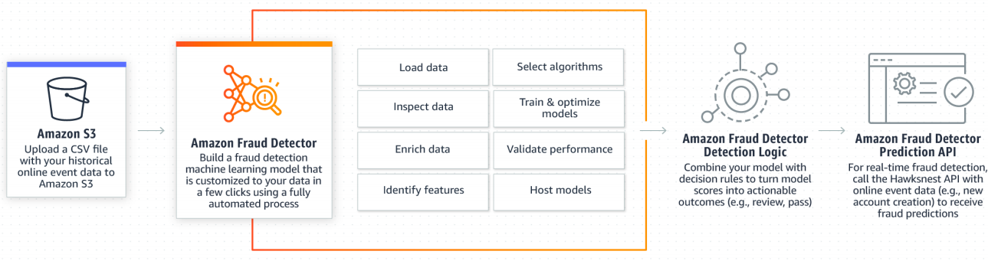
Amazon Fraud Detector .. How it Works

Slide 64
Amazon Textract
Amazon Textract is a fully managed machine learning service that automatically extracts text and data from scanned documents that goes beyond simple optical character recognition (OCR) to identify, understand, and extract data from forms and tables
https://aws.amazon.com/textract/
https://d1.awsstatic.com/events/reinvent/2019/REPEAT_1_AI_document_processing_for_business_automation_AIM211-R1.pdf

Slide 65
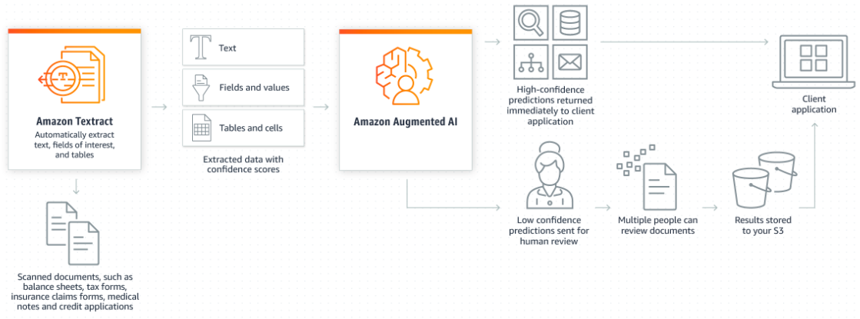
Amazon Textract .. How it Works

Slide 66
Amazon Forecast
Amazon Forecast is a fully managed service that uses machine learning to deliver highly accurate forecasts
https://aws.amazon.com/forecast/
https://d1.awsstatic.com/events/reinvent/2019/Predict_future_business_outcomes_using_Amazon_Forecast_AIM312.pdf
https://d1.awsstatic.com/whitepapers/time-series-forecasting-principles-amazon-forecast.pdf

Slide 67
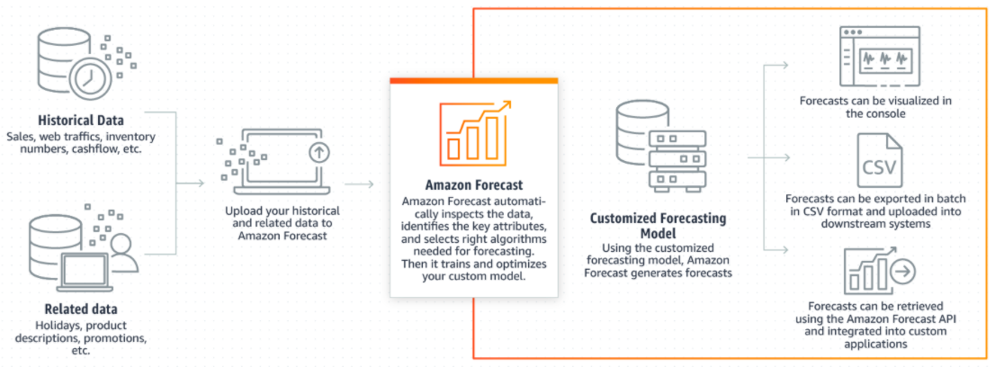
Amazon Forecast .. How it Works

Slide 68
Upcoming Conference
https://reinvent.awsevents.com/

Slide 69


